Slide 1

BULLyING and its impacts
Muhammad Shoaib
Zalaid Butt
Um e Abeeha

Slide 2
Survey Questionnaire
Impacts
Changes In Behavior?
Affect On Academic?
Physical Impact?
Awareness
Reasons of not reporting?
Witness?
Comfort Level?
Personal Information
Age?
Gender?
Bullying Experiences
Personal Experience?
Type of Bullying?
Affects On Mental Health?
Prevention
Additional Measures?
Seeking Support?
Effectiveness Of Institutions?

Slide 3
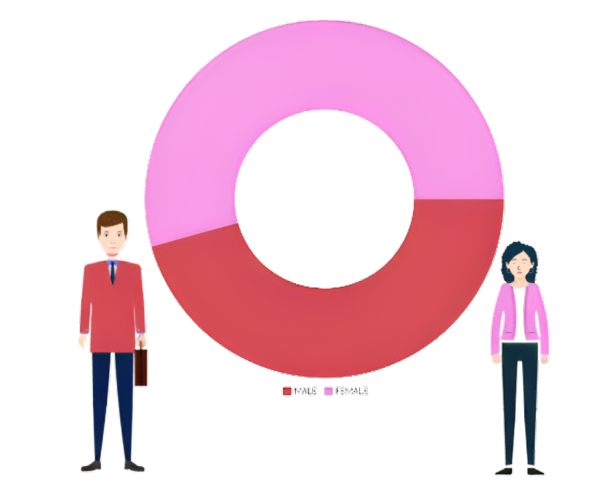
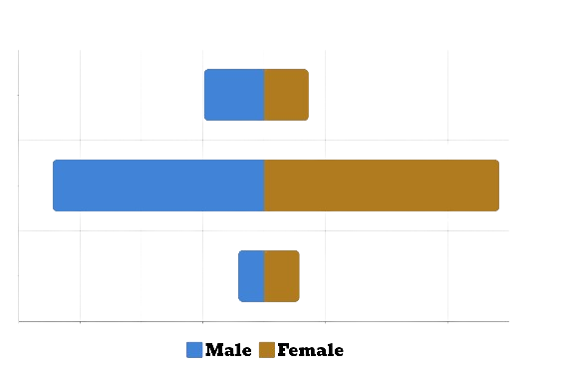
Demographics
51.5%
Under 18
9.8%
7.3%
34.5%
18-22
38.4%
22 Above
48.5%
4.2%
5.8%

Slide 4
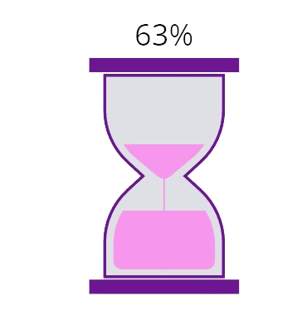
H0 : P1 = P2
Assessment of Questions
Q1: Perception In Bullying Experiences
Method : Hypothesis Test-Two sample Proportion
P1 = Percentage of males experiencing bullying
P2 = Percentage of females experiencing bullying
H1 : P1 < P2 (one tail test)
Result:
Confidence level = 95%, n1 = 64, n2 = 76
Z (cal) =0.48284, Z(tab) = -1.959
Conclusion:
Failed to accept H0, because as shown in our analysis females are being bullied more than males

Slide 5
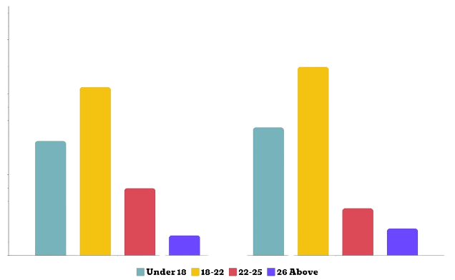


Division of Gender By Ages

Slide 6
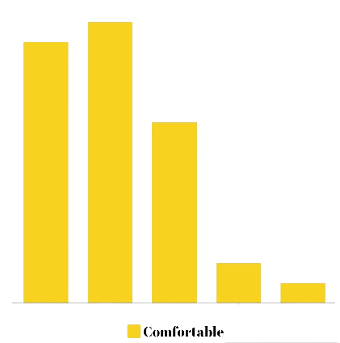
H0: Average of comfort is μ = 4
Assessment of Questions
Q2: Bullying talk comfort: Neutral (mean: 3)
Method : Hypothesis Test-mean one sample
μ= Comfort discussing bullying averages at 4.
H1: Average of comfort is μ < 4 (one tail test)
Result:
1
Confidence level = 95%, n = 152,
Critical-t: 1.65, Test Statistic t: -4.62331
2
3
95% Confidence Interval: 1.963 < µ < 2.931
4
5
Conclusion:
Failed to accept H0, because as shown in our analysis that comfort level is less than 4

Slide 7
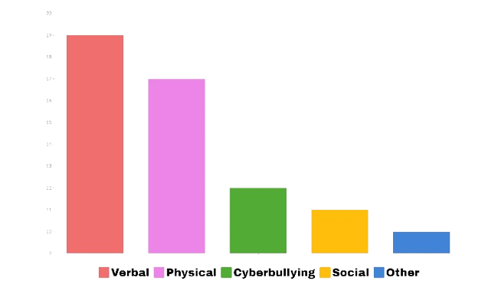
H0 : P1 - P2 = 0.50
Assessment of Questions
Q3: Exploring Bullying Different Encounters
Method : Hypothesis Test-Proportion
P1 = Percentage of People experiencing Verbal bullying
P2 = Percentage of People experiencing Physical bullying
H1 : P1 - P2 < 0.50 (one tail test)
Result:
Confidence level = 90%, n1 = 110, n2 = 90
Critical z:1.645 , Z-Statistic = 4.06
Confidence Interval = 0.15067 < p1-p2 < 0.41499
Conclusion:
Failed to accept H0, because as shown in our analysis that the Confidence Interval of verbal and physical bullied people is less than 0.5

Slide 8
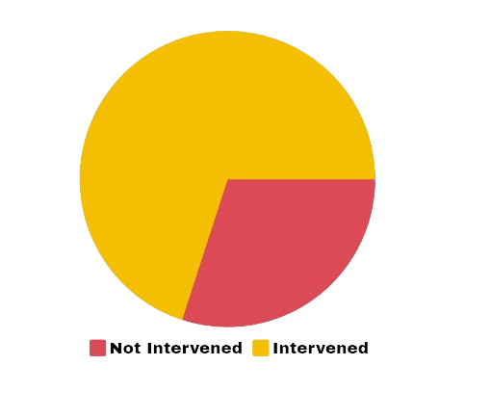
H0 : P1 = P2
Assessment of Questions
Q4: Witnessing Bullying and Providing Support
Method : Hypothesis Test-proportion
P1 = Percentage of people who helped bullied person
P2 = Percentage of people who didn’t help bullied person
H1 : P1 > P2 (one tail test)
69.7%
Result:
Confidence level = 95%, n1 = 82, n2 = 70
30.3%
Test Statistic- z :3.16983, Critical-z = 1.96
95% Confidence Interval : 0.09926 < p1-p2 < 0.40074
Conclusion:
Failed to reject H1, because as shown in our analysis that the Percentage Of People helped the bullied persons is greater than the people who didn’t help.

Slide 9
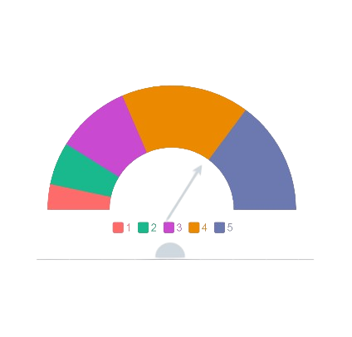
H0 : Impact on mental health = 3
Assessment of Questions
Q5: Effects on mental health mean
Method: Hypothesis Test-mean one sample
μ = Average of bullying impact on mental health is at 3
H1 : Impact on mental health > 3 (One tail test)
Result:
Confidence level = 90%, n = 152
Critical-t: 1.28 Test Statistic-t: 2.46577
90% Confidence Interval: 3.16440 < µ < 3.83560
Conclusion
Failed to accept H0, because as shown in our analysis that effect of mental health is greater than 3

Slide 10
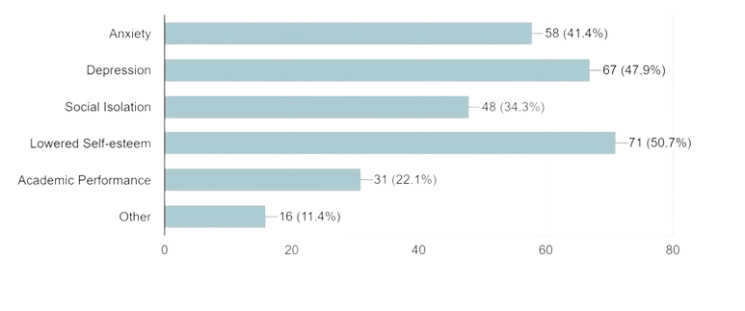
Consequences on Mental Health
Bullying Can Significantly impact mental health by causing stress , anxiety , depression & low self-esteem in individuals who experience it

Slide 11
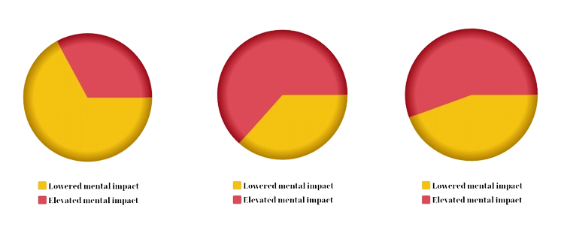
Mental Stress On Different Age Groups
22 Above
Under 18
18-22

Slide 12
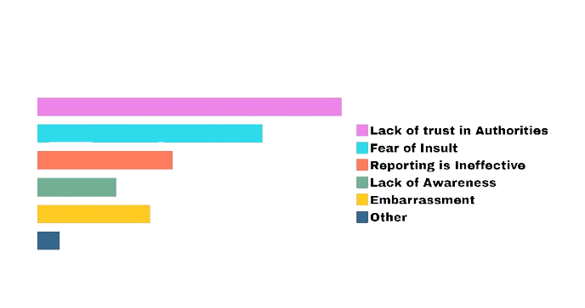
H0 : P0 = 0.40
Assessment of Questions
Q6: Factors Influencing Non-Reporting Bullying
Method : Hypothesis Test-Proportion
P0 = Percentage of Lack of trust in authorities
H1 : P0 ≠ 0.40 (two tail test)
Result:
Confidence level = 95%, n=152, P-hat=0.40
Test Statistic-z:0.0 , Critical-Z = 1.96
95% Confidence Interval: 0.30398 < p < 0.49602
Conclusion:
Failed to reject H0, because as shown in our analysis that the Percentage Of Lack of Trust In Authorities is equal to 0.60

Slide 13
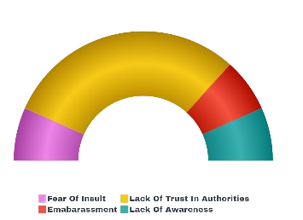
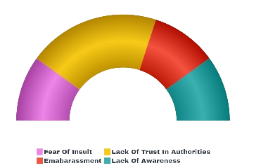
Gender Based : Non-Reporting Factors
Males Data Analytics
Females Data Analytics

Slide 14


H0 : P1 - P2 = 0.30
Assessment of Questions
Q7: Exploring Bullying Different Encounters
Method : Hypothesis Test-Proportion
P1 = Percentage of People experiencing Social bullying
P2 = Percentage of People experiencing Cyberbullying
Social
H1 : P1 - P2 < 0.30 (one tail test)
Cyberbullying
Result:
Confidence level = 95%, n1 = 120, n2 = 105
Z(tab) = 1.96
Confidence Interval = 0.193 ± 0.08
Conclusion:
Failed to accept H0, because as shown in our analysis that the Confidence Interval of Social and Cyberbullied people is less than 0.3

Slide 15
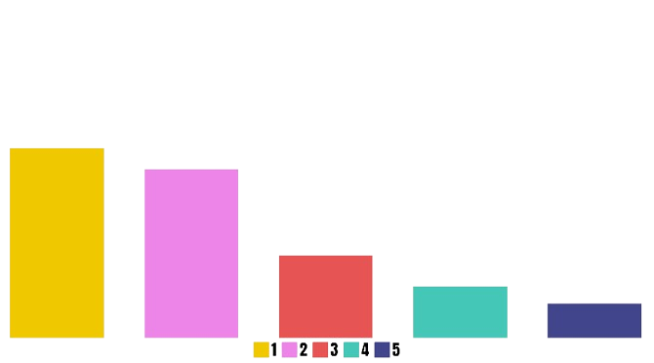
H0 : μ1 = μ2
Assessment of Questions
Q8: Institutional effectiveness against bullying
Method : Hypothesis Test-mean two sample
μ1 = Institution’s bullying prevention is effective
μ2= Institution’s bullying prevention is not effective
Very Likely
Likely
H1 : μ1 < μ2 (one tail test)
Neutral
Result:
Unlikely
Very Unlikely
Confidence level = 95%, n1 = 72, n2 = 78
Critical t: -1.97549, Test Statistic-t: 35.19770
95% Confidence Interval: 21.70912 < µ1-µ2 < 24.29088
Conclusion:
Failed to accept H0, because as shown in our analysis that Institutional effectiveness against bullying mean is more

Slide 16
Conclusion
Highlights:
Understand that bullying hurts people emotionally and mentally
It leads to higher rates of anxiety, depression and low self-esteem
Doubt that authorities will handle the issue effectively
If you see someone being bullied, speak up and help them
✓
Raise Awareness:
Enforce Policies
Support Victims
Blaming the Victim
Tolerate Bullying
✓
✓

Slide 17
THANK
YOU!

